Slide 1
DATE: FEBRUARY 17, 2024
TIME: 12:30-5:00 PM
PLACE: NEVADA BAPTIST CHURCH
WHO: TEENS 6th - 12th GRADE
Notes:
Still image slide.
Feel free to adjust the slides however you wish as long as the info remains accurate ☺.

Slide 2
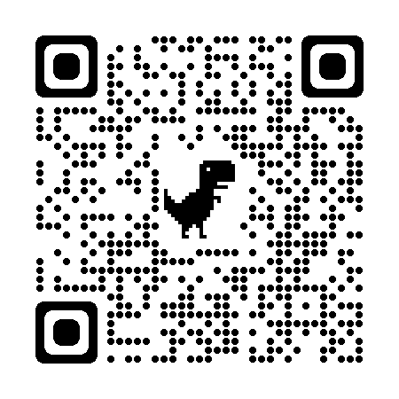
What is Monopoly Madness?
Nevada Baptist invites your Youth Group to attend the Annual Monopoly Madness youth event. It is a day filled with the game of monopoly. There are at least 30 games going at one time. The goal is to create an event to reach the lost with an evangelistic message and encourage fellowship within our youth groups. The point of the game is to make monopoly money and advance to the next level of play. Each level allows the chance to make, or lose, even more money than before. At the end of the afternoon, there will be an opportunity to shop our Monopoly Madness Store with the money you made playing. The store will have over $2,000 worth in prizes to be redeemed!
The Details:
Location:
Nevada Baptist Church
210 West 3rd St
Nevada, Iowa 50201
515-382-4823
For more information contact:
Jonathan Tilson
402-979-9366
mtnjonathandew@gmail.com
Register Online at https://www.eventcreate.com/e/monopolymadness2024
Or Scan QR Code
COST: $15 Pre-register by
February 10st, 2024 $25 At the Door
Price includes: Game, Prizes, and Food!
Teens 6th - 12th Grade.
February 17th, 2022 12:30 PM – 5:00 PM
Speaker:
Matt Reno

Slide 3
Nevada Baptist Church
Teens 6th – 12th Grade
February 17
12:30pm – 5:00pm
Notes:
Animated Slides.
Let this slide transition (morph) to the following slide (after 2-3 seconds) to get the full animation effect.

Slide 4
Nevada Baptist Church
Teens 6th – 12th Grade
February 17
12:30pm – 5:00pm

